Slide 1
Assumptions
Quarterly dash board to President
Reports progress
Reports on levers/opportunities to change
Fiscal Year = Calendar Year
Important Things
Digestibility, quick to understand
Good design
Adhere to good viz principles (color blind, good charts)

Slide 2
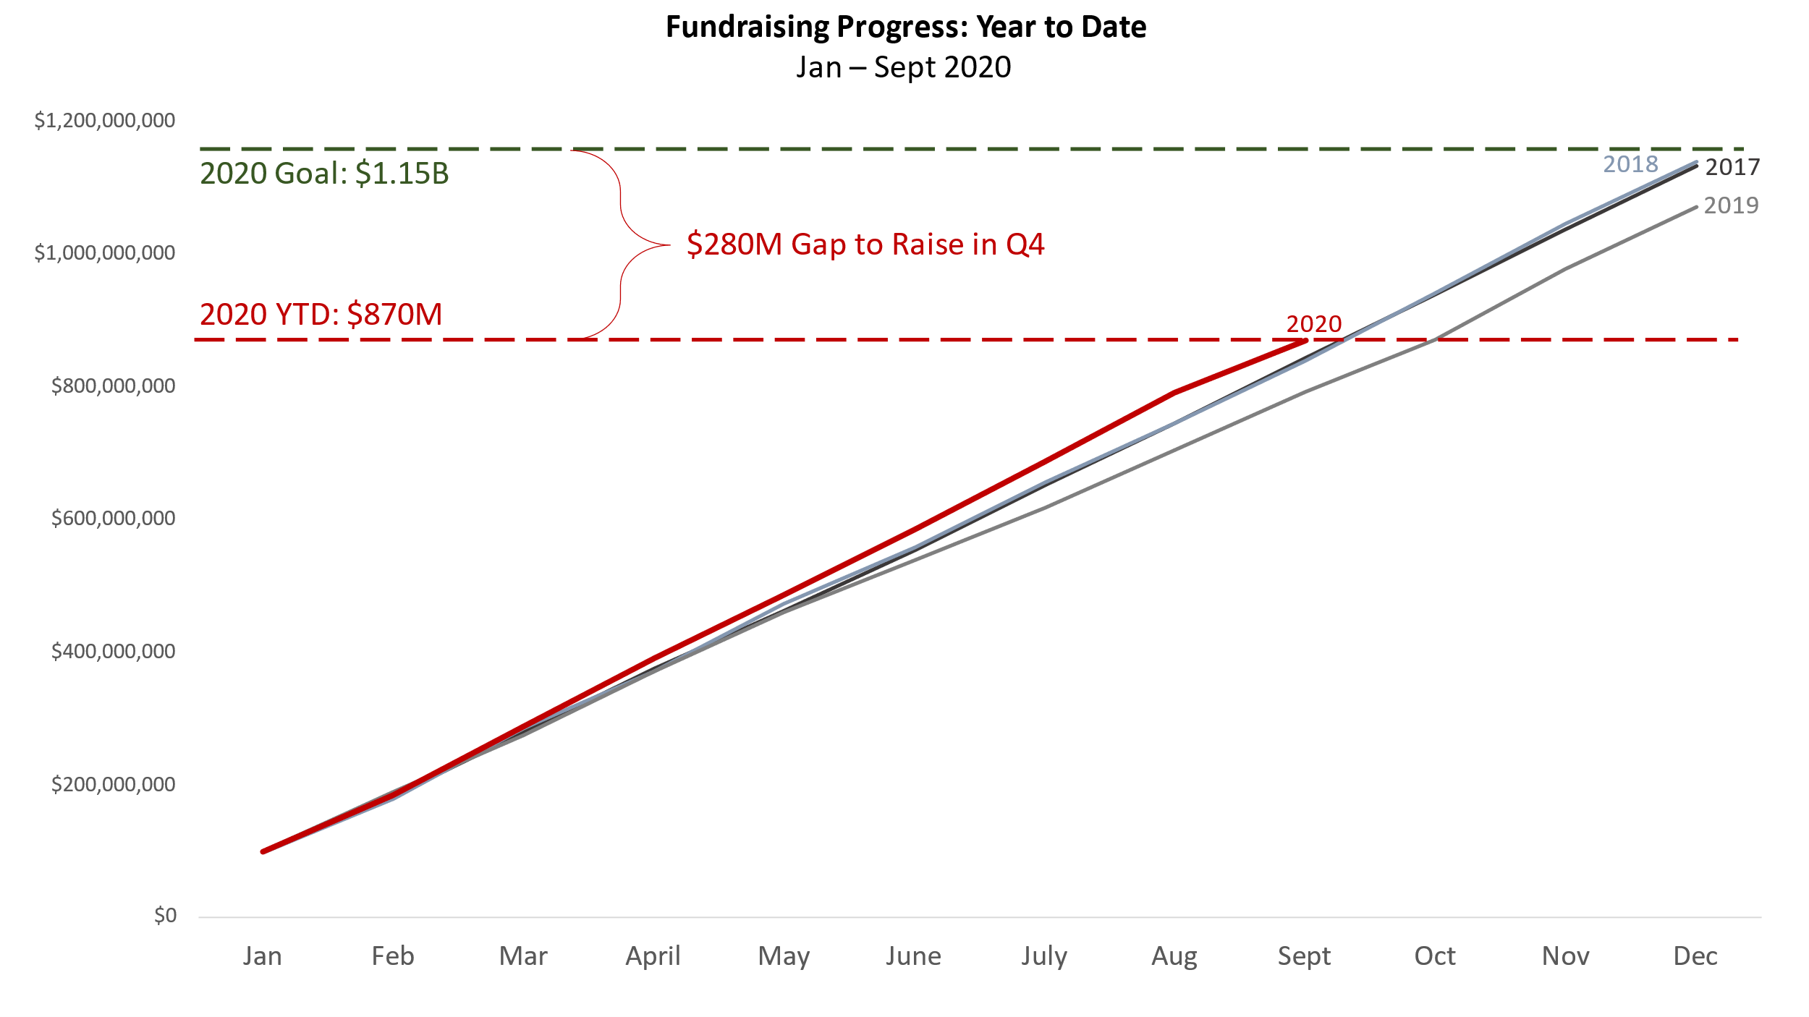
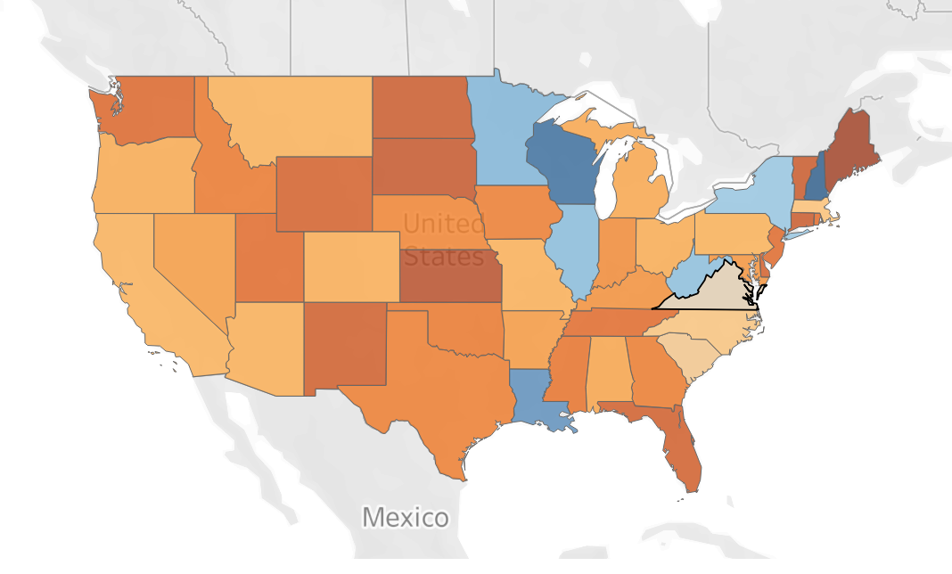
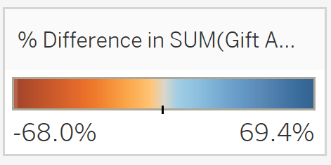
Previous Quarter Highlights
Dollars raised in Q3?
Donors Contacted?
Engagements?
Portfolio Contact Progress
LYBUNT
SYBUNT
w. Capacity rating, Last Gift Amt, Last Contact
XX%
Segments
Geographical
Event
Last Contact
Volunteer
Quarter Priorities
Key priorities to meet goal
Assistance needed from VP

